Slide 1
Measuring Length and Area
Geometry
Chapter 11
Notes:
Geometry 11

Slide 2
This Slideshow was developed to accompany the textbook
  Big Ideas Geometry
  By Larson and Boswell
  2022 K12 (National Geographic/Cengage)
Some examples and diagrams are taken from the textbook.
Slides created by
Richard Wright, Andrews Academy
rwright@andrews.edu

Slide 3
11.1 Areas of Triangles and Parallelograms (1.4)
After this lesson…
I can find the perimeter of rectangles and triangles.
I can find the area of rectangles and triangles.

Slide 4
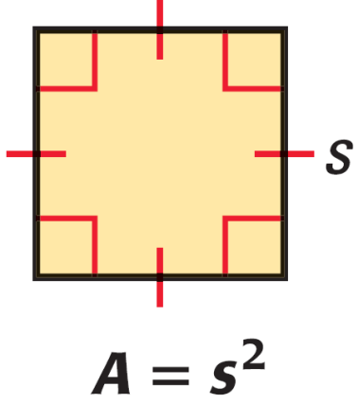

11.1 Areas of Triangles and Parallelograms (1.4)
Area of a Square
$$A=s^{2}$$
Where s is the length of a side.
Area Congruence Postulate
If 2 polygons are congruent, then they have the same area.
Area Addition Postulate
The total area is the sum of the areas of the nonoverlapping parts.

Slide 5
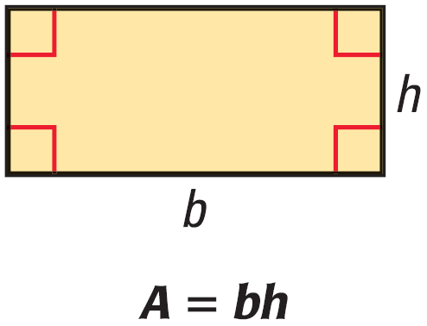
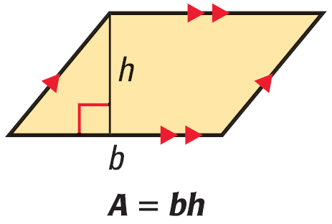
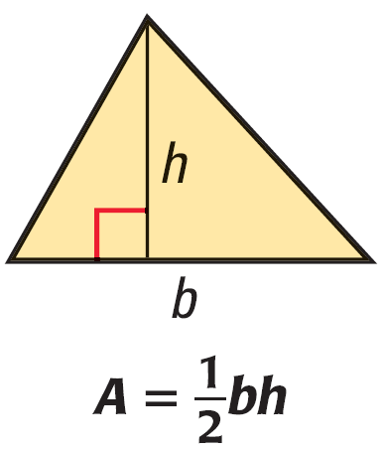



11.1 Areas of Triangles and Parallelograms (1.4)
Area of a Rectangle
$$A=bh$$
Where b is the base and h is the height.
Area of a Parallelogram
$$A=bh$$
Where b is the base and h is the height.
Area of a Triangle
$$A=\frac{1}{2}bh$$
Where b is the base and h is the height.
Notes:
Rectangle can be divided into b by h unit squares.
Parallelogram can be cut apart and built into a rectangle.
Triangle is ½ a parallelogram.

Slide 6
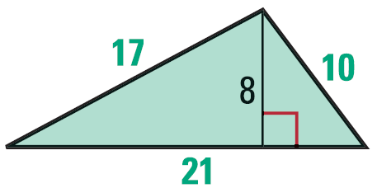
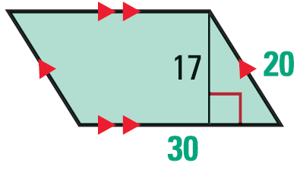
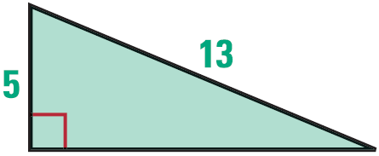
11.1 Areas of Triangles and Parallelograms (1.4)
Find the perimeter and area of the polygon.
Notes:
$$P=17+10+21=48$$
$$A=\frac{1}{2}\left(21\right)\left(8\right)=84$$
$$P=20+30+20+30=100$$
$$A=30\left(17\right)=510$$
$$a^{2}+b^{2}=c^{2}$$
$$5^{2}+b^{2}={13}^{2}$$
$$25+b^{2}=169$$
$$b^{2}=144$$
$$b=12$$
$$P=5+12+13=30$$
$$A=\frac{1}{2}\left(5\right)\left(12\right)=30$$

Slide 7
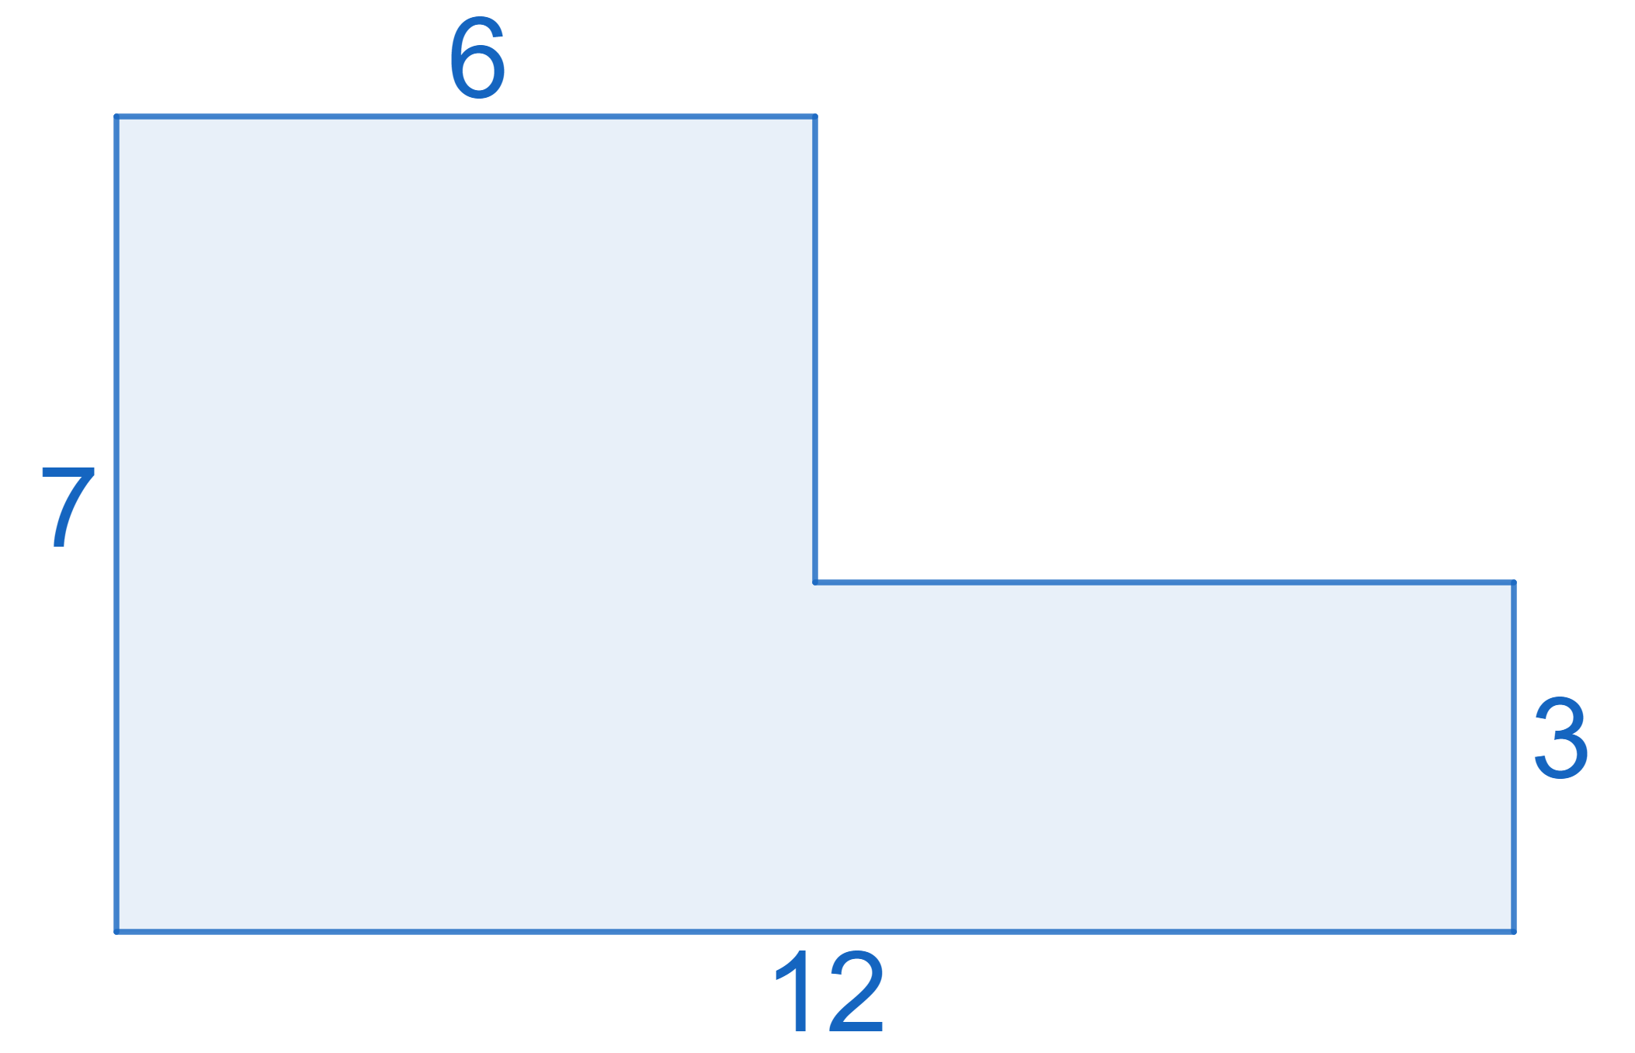
11.1 Areas of Triangles and Parallelograms (1.4)
A parallelogram has an area of 153 in² and a height of 17 in. What is the length of the base?
Find the area.
Notes:
$$A=bh$$
$$153=b17$$
$$b=9$$
Length of right rectangle is 6
$$A=7\left(6\right)+3\left(6\right)=60$$

Slide 8
11.2 Areas of Trapezoids, Rhombuses, and Kites (11.3)
After this lesson…
I can find the area of trapezoids.
I can find the area of rhombuses.
I can find the area of kites.

Slide 9
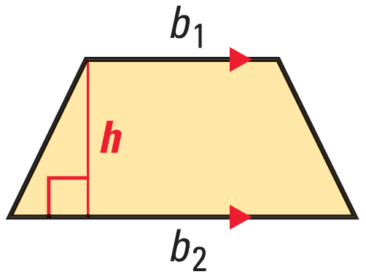
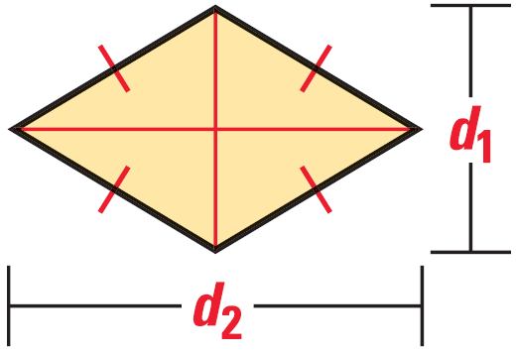


11.2 Areas of Trapezoids, Rhombuses, and Kites (11.3)
Area of a Trapezoid
$$A=\frac{1}{2}h\left(b_{1}+b_{2}\right)$$
Where h is the height and b₁ and b₂ are the bases.
Area of a Rhombus
$$A=\frac{1}{2}d_{1}d_{2}$$
Where d₁ and d₂ are the diagonals.
Notes:
Trapezoid is a triangle + parallelogram
$$A=\frac{1}{2}(b_{2}−b_{1})h+b_{1}h$$
$$A=\frac{1}{2}b_{2}h−\frac{1}{2}b_{1}h+b_{1}h$$
$$A=\frac{1}{2}b_{2}h+\frac{1}{2}b_{1}h$$
$$A=\frac{1}{2}h\left(b_{1}+b_{2}\right)$$
Rhombus is four small triangles
$$A=4\left(\frac{1}{2}\left(\frac{1}{2}d_{1}\right)\left(\frac{1}{2}d_{2}\right)\right)$$
$$A=\frac{4}{8}d_{1}d_{2}$$
$$A=\frac{1}{2}d_{1}d_{2}$$

Slide 10
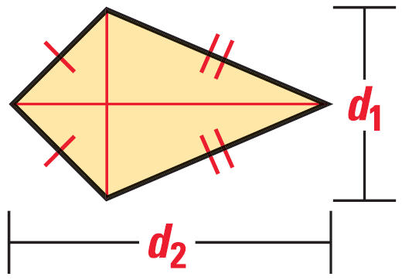
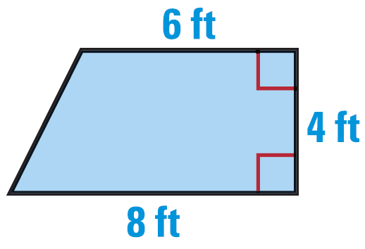
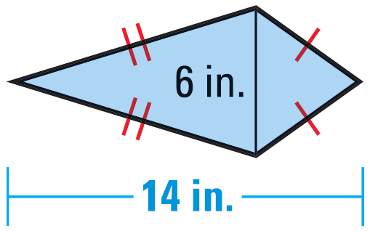
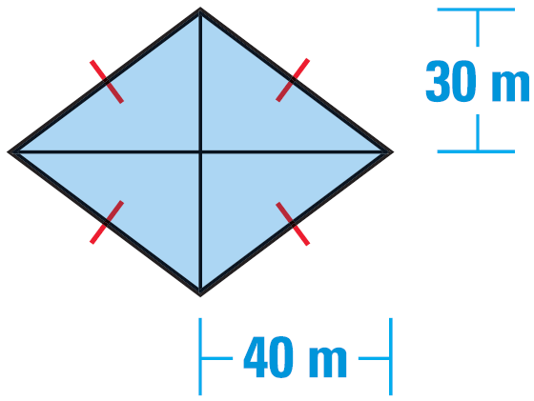

11.2 Areas of Trapezoids, Rhombuses, and Kites (11.3)
Area of a Kite
$$A=\frac{1}{2}d_{1}d_{2}$$
Where d₁ and d₂ are the diagonals.
Find the area
Notes:
A Kite is two triangles with base d₂ and height ½ d₁
$$A=2\left(\frac{1}{2}\left(d_{2}\right)\left(\frac{1}{2}d_{1}\right)\right)$$
$$A=\frac{2}{4}d_{1}d_{2}$$
$$A=\frac{1}{2}d_{1}d_{2}$$
Trapezoid
$$A=\frac{1}{2}4\left(6+8\right)=28$$
Kite
$$A=\frac{1}{2}\left(6\right)\left(14\right)=42$$
Rhombus
$$A=\frac{1}{2}\left(80\right)\left(60\right)=2400$$

Slide 11
11.2 Areas of Trapezoids, Rhombuses, and Kites (11.3)
The area of a kite is 80 ft². One diagonal is 4 times as long as the other. Find the diagonal lengths.
Find the area of a rhombus with vertices M(1, 3), N(5, 5), P(9, 3) and Q(5, 1).
Notes:
Kite
$$A=\frac{1}{2}d_{1}d_{2}$$
$$d_{1}=4d_{2}$$
$$80=\frac{1}{2}4d_{2}\left(d_{2}\right)$$
$$80=2d_{2}^{2}$$
$$40={\left(d_{2}\right)}^{2}$$
$$d_{2}=2\sqrt{10}$$
$$d_{1}=8\sqrt{10}$$
Rhombus
Diagonals are $d_{1}=8, d_{2}=4$
$$A=\frac{1}{2}\left(8\right)\left(4\right)=16$$

Slide 12
11.3 Circumference and Arc Length (11.1)
After this lesson…
I can use the circumference of a circle to find measures.
I can find arc lengths and use arc lengths to find measures.

Slide 13
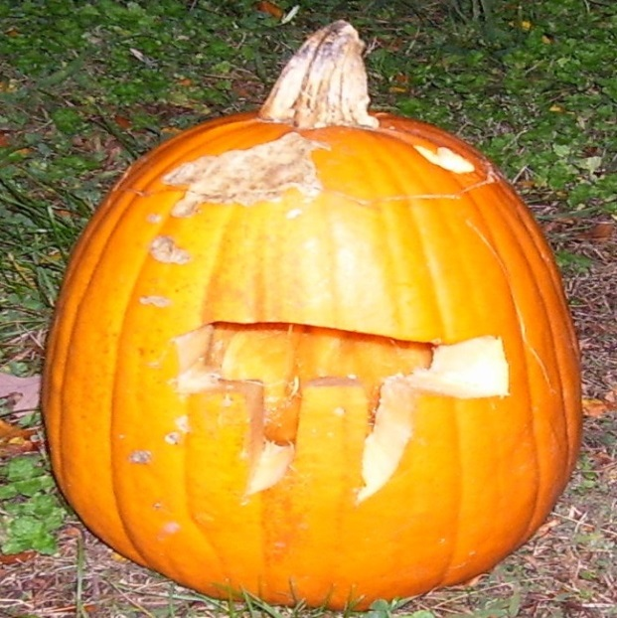

11.3 Circumference and Arc Length (11.1)
Circumference of a Circle
Distance around the circle
Like perimeter
π
Ratio of the circumference to the diameter of a circle
Estimated in 2 Chronicles 4:2 and 1 Kings 7:23 as 3
3.141592654…
$$C=πd$$
$$C=2πr$$

Slide 14
11.3 Circumference and Arc Length (11.1)
Find the circumference of a circle with diameter 5 inches.
Find the diameter of a circle with circumference 17 feet.
A car tire has a diameter of 28 inches. How many revolutions does the tire make while traveling 500 feet?
Notes:
$$C=πd$$
$$C=π5=15.7 in$$
$$17=πd$$
$$\frac{17}{π}=d$$
$$d=5.41 ft$$
$$28 in=2\frac{1}{3}ft$$
$$C=π\left(2\frac{1}{3}\right)=7.3304 ft$$
$$Revoultions=\frac{500}{7.3304}=68.2 rev$$

Slide 15
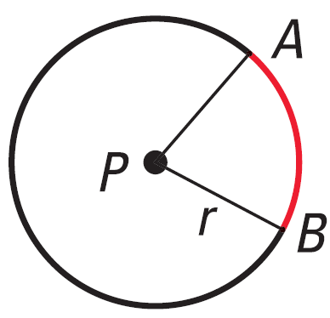
11.3 Circumference and Arc Length (11.1)
Arc Length
Portion of the circumference that an arc covers
Arc Length
$$\text{Arc} \text{Length}=\frac{\text{Arc} \text{Measure}}{360°}⋅2πr$$
Notes:
$$Arc Length \overset{⏜}{AB}=\frac{m\overset{⏜}{AB}}{360°}⋅2πr$$

Slide 16
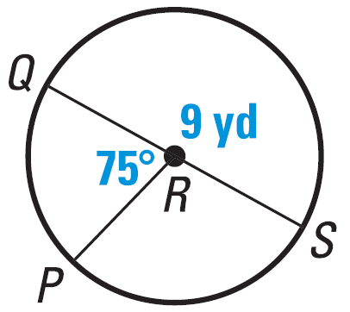
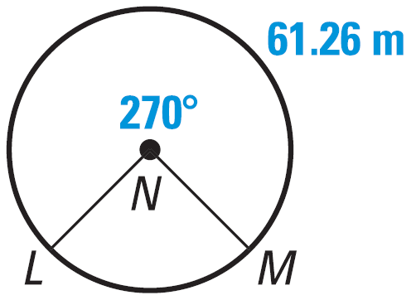

11.3 Circumference and Arc Length (11.1)
Find the length of $\overset{⏜}{PQ}$.
Find the Circumference of $⨀N$.
Notes:
$$r=4.5 yd$$
$$Arc Length \overset{⏜}{PQ}=\frac{75}{360}⋅2π4.5 yd=5.89 yd$$
$$Arc Length =61.26 m$$
$$61.26 m=\frac{270}{360}⋅2πr$$
$$61.26 m=.75⋅2πr$$
$$81.7 m=2πr=C$$

Slide 17
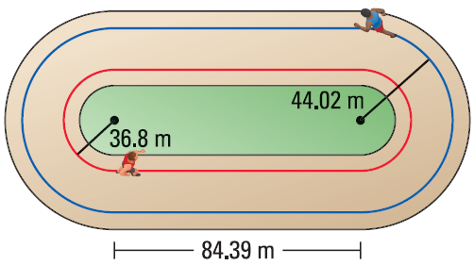
11.3 Circumference and Arc Length (11.1)
How far does the runner on the blue path travel in one lap. Round to the nearest tenth of a meter.
Notes:
The two ends make a circle
$$C=2π44.02 m=276.59 m$$
Add the two straight stretches
$$276.59 m+2\left(84.39 m\right)=445.4 m$$

Slide 18
11.4 Areas of Circles and Sectors (11.2)
After this lesson…
I can use the formula for area of a circle.
I can find areas of circles and sectors.
I can solve problems involving areas of sectors.

Slide 19
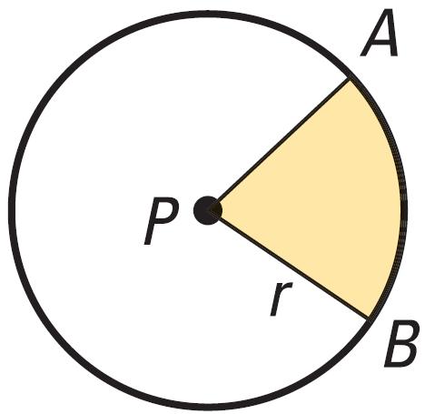
11.4 Areas of Circles and Sectors (11.2)
Area of a Circle
$$A=πr^{2}$$
Sector of a Circle
Fraction of a Circle
Area of a Sector
$$A=\frac{\text{Arc} \text{Measure}}{360°}⋅πr^{2}$$

Slide 20
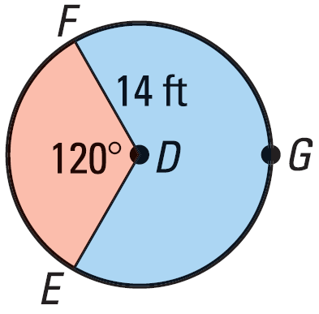

11.4 Areas of Circles and Sectors (11.2)
Find area of $⨀D$
Find area of red sector
Find area of blue sector
Notes:
$$A=π{14}^{2}=615.8 ft^{2}$$
$$A=\frac{120}{360}π{14}^{2}=205.3 ft^{2}$$
$$A=\frac{240}{360}π{14}^{2}=410.5 ft^{2}$$

Slide 21
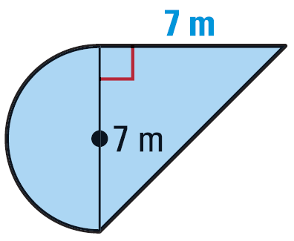
11.4 Areas of Circles and Sectors (11.2)
Find the area of the figure.
Notes:
Semicircle
$$A=\frac{1}{2}\left(π{3.5}^{2}\right)=19.2423 m^{2}$$
Triangle
$$A=\frac{1}{2}\left(7\right)\left(7\right)=24.5 m^{2}$$
Total
$$19.2423 m^{2}+24.5{ m}^{2}=43.7 m^{2}$$

Slide 22
11.5 Areas of Regular Polygons (11.3)
After this lesson…
I can find the angle measures in regular polygons.
I can find areas of regular polygons.

Slide 23

11.5 Areas of Regular Polygons (11.3)
Now that we know how to find the area of a triangle we can find the area of any polygon since it can be broken up into triangles.
For example find the area of a stop sign.
$A=\frac{1}{2}Pa$
a
s
Notes:
It has 8 sides, I’ll call them s.
If we draw lines connecting opposite vertices, we have 8 identical triangles.
Draw the altitudes from the center of the sign and call it a.
The area of each triangle is ½ sa.
The area of the sign then is 8(½ sa).
But the perimeter, P, is 8s, so the Area = ½ Pa.

Slide 24

11.5 Areas of Regular Polygons (11.3)
Apothem
  A segment drawn from the center of a regular polygon perpendicular to the edge (also bisects edge)
Area of a Regular Polygon
$$A=\frac{1}{2}Pa$$
Where P is the perimeter and a is the apothem

Slide 25

11.5 Areas of Regular Polygons (11.3)
Typical steps to find area of regular polygon
Find ½ of central angle
  $\frac{1}{2}\left(\frac{360}{n}\right)$
Use trigonometry to find apothem
  tan, sin, cos
  Find perimeter
  P = ns
  $A=\frac{1}{2}Pa$
a
s

Slide 26
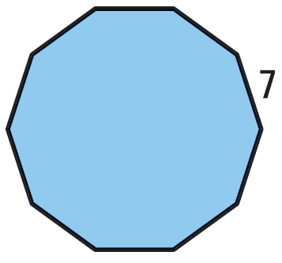
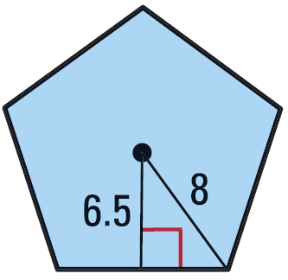
11.5 Areas of Regular Polygons (11.3)
  Find the area of the regular polygon.
Notes:
Pentagon
Pythagorean theorem to find side
$${6.5}^{2}+x^{2}=8^{2}$$
$$42.25+x^{2}=64$$
$$x^{2}=21.75$$
$$x=\frac{\sqrt{87}}{2}=4.6637$$
$$s=2x=9.3274$$
Area
$$A=\frac{1}{2}\left(9.3274⋅5\right)\left(6.5\right)=151.6$$
Decagon
Find ½ central angle
$$\frac{1}{2}\left(\frac{360}{10}\right)=18°$$
Find apothem
$$\tan{18°}=\frac{3.5}{a}$$
$$a⋅\tan{18°}=3.5$$
$$a=10.7719$$
Find area
$$A=\frac{1}{2}\left(7⋅10\right)\left(10.7719\right)=377.0$$

Slide 27
11.5 Areas of Regular Polygons (11.3)
A regular hexagon is inscribed in a circle with a diameter of 32 units. Find the area of the hexagon.
Notes:
Radius is 16
½ central angle
$$\frac{1}{2}\left(\frac{360°}{6}\right)=30°$$
Apothem
$$\cos{30°}=\frac{a}{16}$$
$$a=16\cos{30°}=8\sqrt{3}$$
Side length
$$\sin{30°}=\frac{x}{16}$$
$$x=16\sin{30°}=8$$
$$s=2x=16$$
Perimeter
$$P=6s=6\left(16\right)=96$$
Area
$$Area=\frac{1}{2}Pa$$
$$Area=\frac{1}{2}\left(96\right)\left(8\sqrt{3}\right)=665.11$$

Slide 28
11.6 Use Geometric Probability
After this lesson…
I can find probabilities involving segments.
I can find probabilities involving areas.

Slide 29
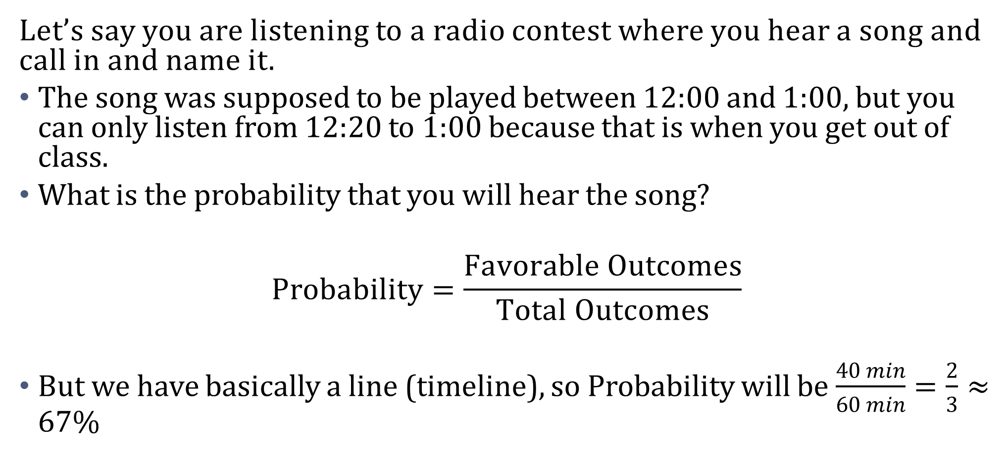
11.6 Use Geometric Probability
Let’s say you are listening to a radio contest where you hear a song and call in and name it.
  The song was supposed to be played between 12:00 and 1:00, but you can only listen from 12:20 to 1:00 because that is when you get out of class.
  What is the probability that you will hear the song?
$$\text{Probability}=\frac{\text{Favorable} \text{Outcomes}}{\text{Total} \text{Outcomes}}$$
  But we have basically a line (timeline), so Probability will be $\frac{40 min}{60 min}=\frac{2}{3}≈67\%$

Slide 30
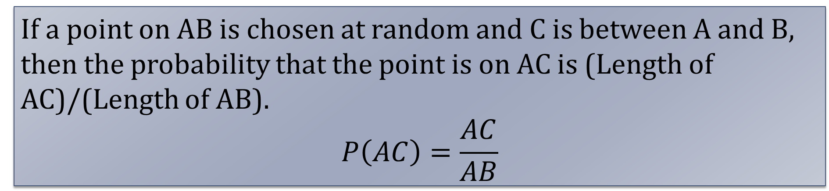
11.6 Use Geometric Probability
Length Probability Postulate
If a point on AB is chosen at random and C is between A and B, then the probability that the point is on AC is (Length of AC)/(Length of AB).
$$P\left(AC\right)=\frac{AC}{AB}$$
A
C
B

Slide 31
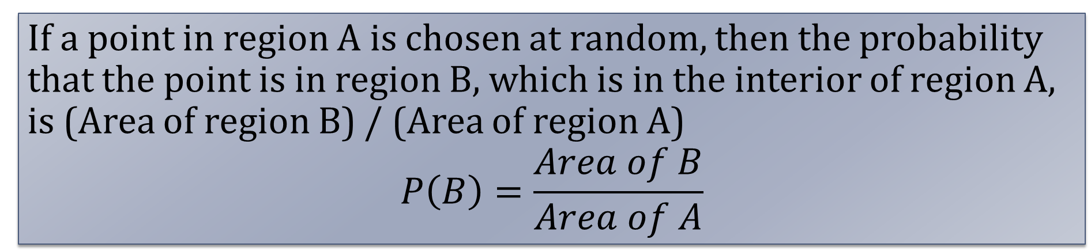
11.6 Use Geometric Probability
Area Probability Postulate
If a point in region A is chosen at random, then the probability that the point is in region B, which is in the interior of region A, is (Area of region B) / (Area of region A)
$$P\left(B\right)=\frac{Area of B}{Area of A}$$
A
B

Slide 32
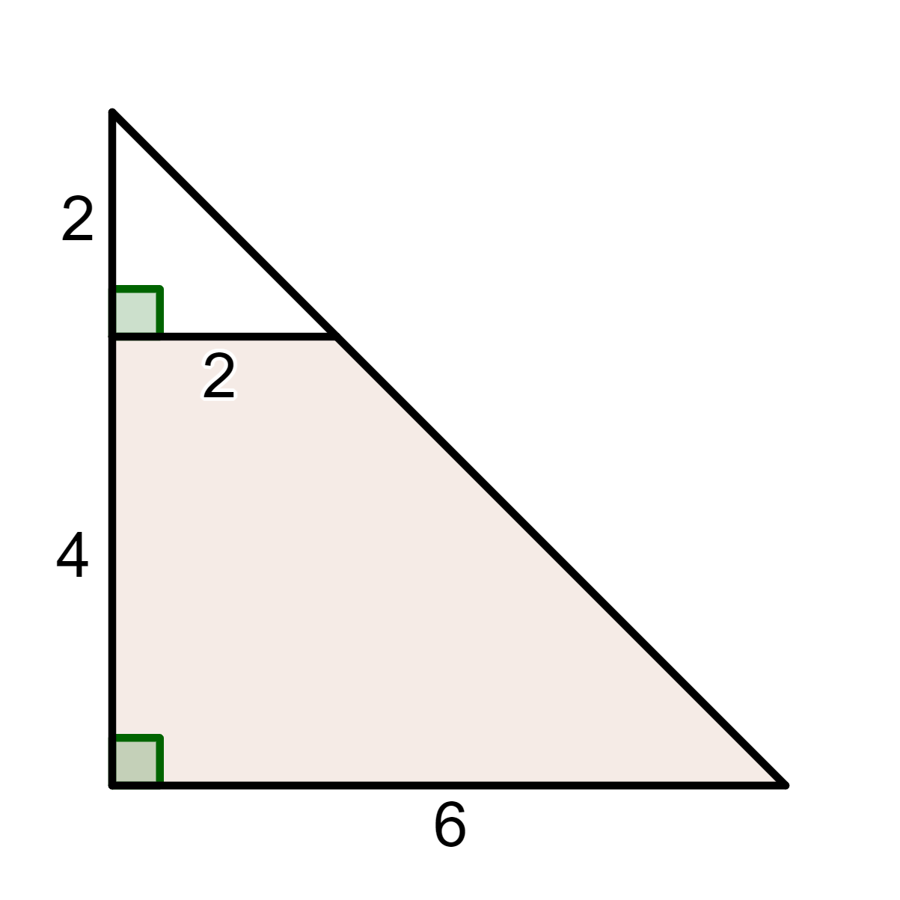
11.6 Use Geometric Probability
Find the probability that a random point is in the shaded region.
Notes:
$$P\left(shaded\right)=\frac{trapezoid}{big triangle}$$
$$=\frac{\frac{1}{2}h\left(b_{1}+b_{2}\right)}{\frac{1}{2}bh}$$
$$=\frac{\frac{1}{2}\left(4\right)\left(2+6\right)}{\frac{1}{2}\left(6\right)\left(6\right)}$$
$$=\frac{16}{18}$$
$$=\frac{8}{9}≈88.9\%$$

Slide 33
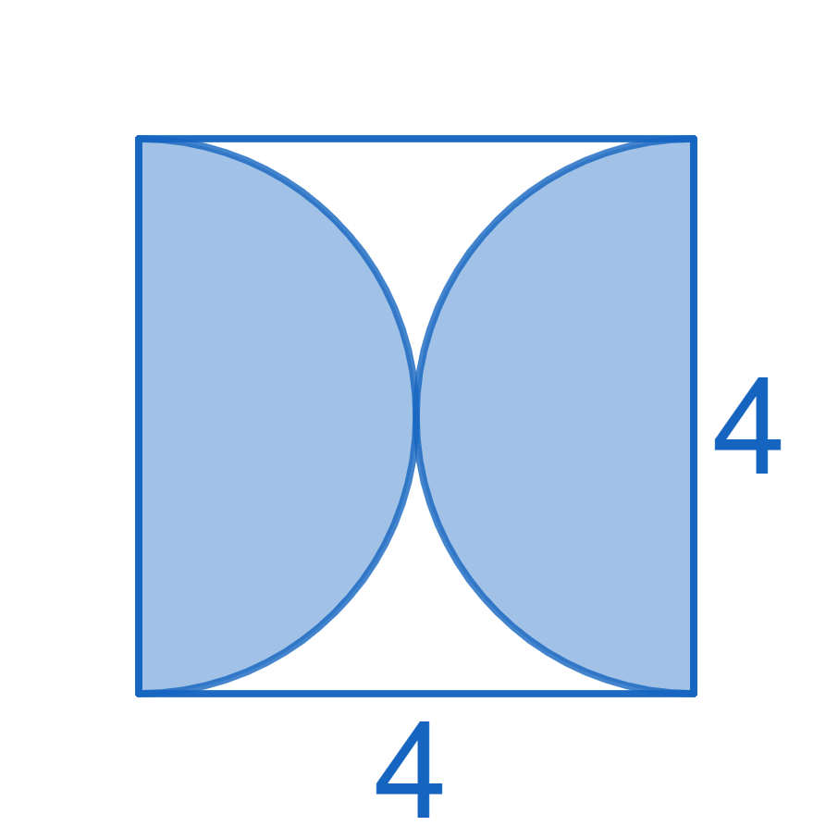
11.6 Use Geometric Probability
Find the probability that a random point is in the shaded region.
Notes:
$$P\left(shaded\right)=\frac{2 semicircles}{square}$$
$$=\frac{\left(2·\frac{1}{2}πr^{2}\right)}{s^{2}}$$
$$=\frac{πr^{2}}{s^{2}}$$
$$=\frac{π{\left(2\right)}^{2}}{4^{2}}=\frac{π}{4}≈0.7854≈78.54\%$$

